Slide 1

Preliminary Design Review
Matt Clark
Ander Solorzano
Jaghvi Mehta
Stephen Smith
Notes:
Ladies and Gentleman, welcome to our preliminary design review.
I’m Stephen
…
and we are …
FIELDROID

Slide 2
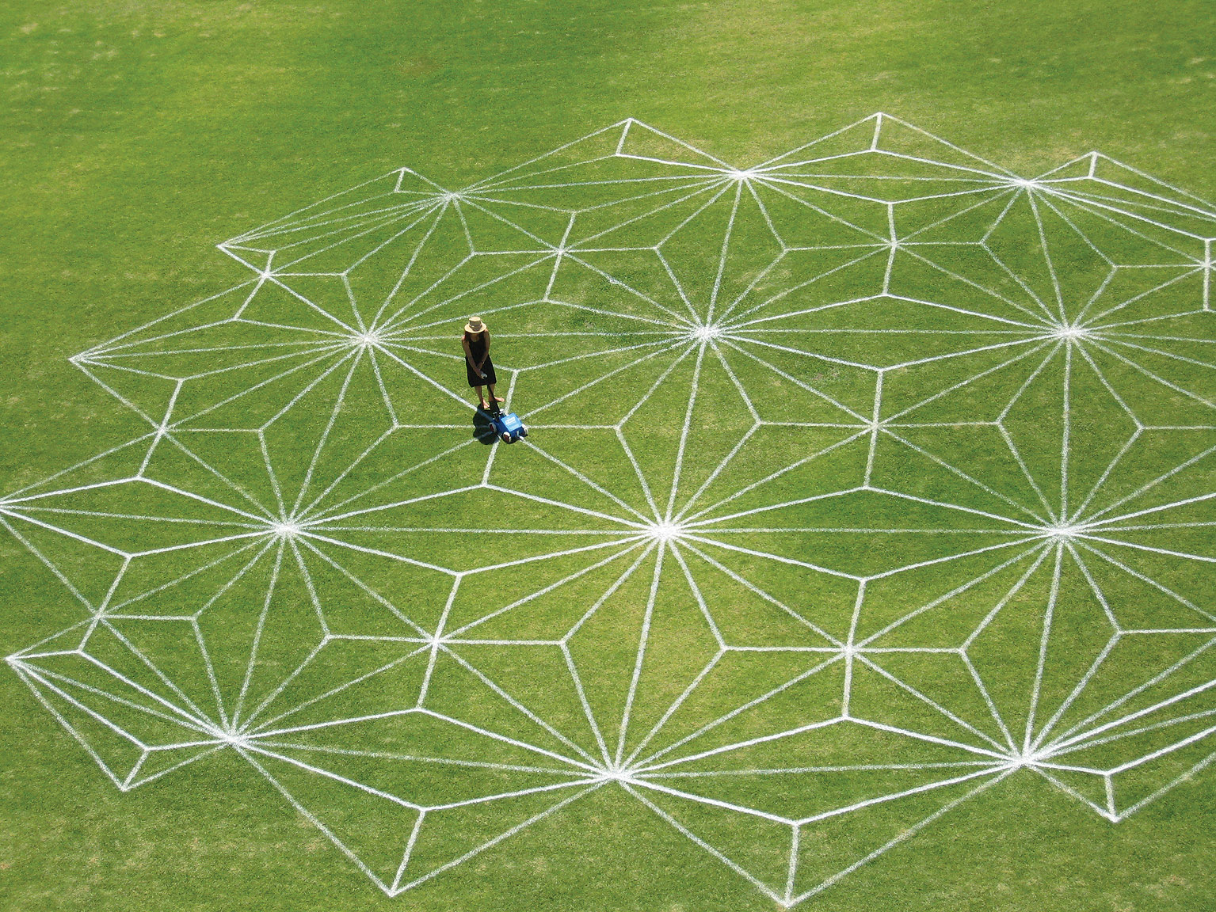
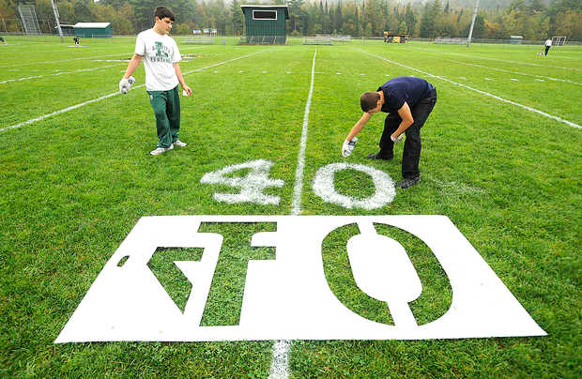
Project Description - Problem
Field painting is difficult
and complex
Leagues need more:
Time
Money
People
A Stunning Field Inspires!
Notes:
I’m sure everyone here has been to a sports game at some point in their lives. I mean who hasn’t? Have you ever thought about how they get all of the lines and features on the field? It is a pretty painful task. People spend hours on these lines and graphics. A turf management team wastes money on the high cost of these skilled laborers.
It is considered an honor to play on any of the well painted fields around the country. So why can’t every field be stadium quality?

Slide 3
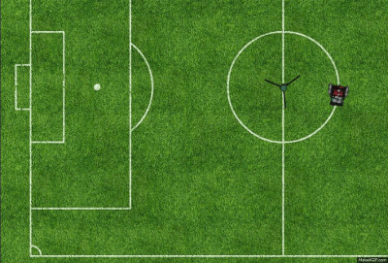
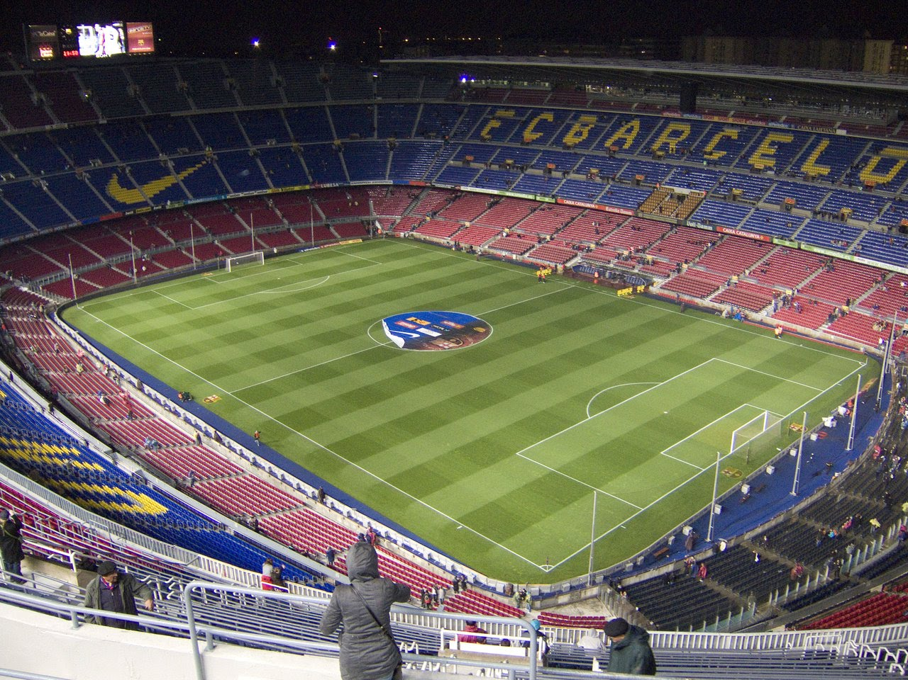
Project Description - Solution
FielDroid is a field painting robot
The FielDroid is:
Faster than manual painting
Resource efficient
Completely autonomous
Play like a pro!
Notes:
So, we present to you Fieldroid, an autonomous robot that makes this task faster, cheaper, and mistake free. The robot can be given the field type and dimensions and is then able to paint the whole thing without stopping. Athletes all over the world will now be able to play on a professionally painted field.
So what would a real world situation look like?

Slide 4
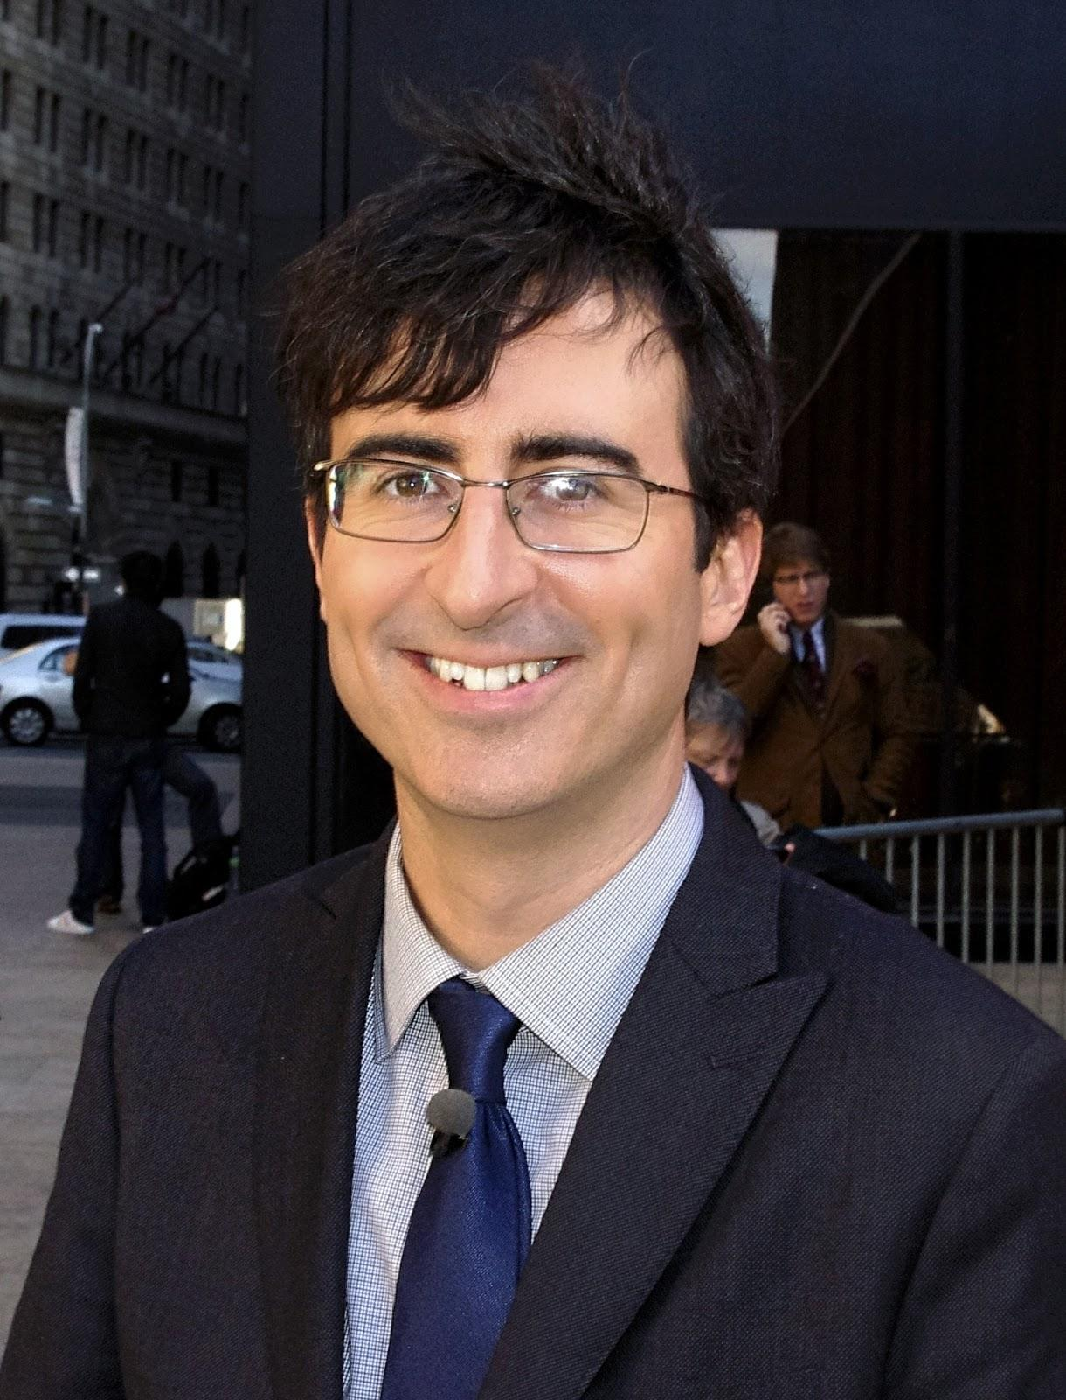
Use Case
Notes:
Give a brief refined use case coupled with a graphical representation of the system in its use case/mission environment. For example, if you are creating an Explosive Ordnance Disposal (EOD) robot, the figure should show not only the robot, but the likely bomb site, the area to be traversed to reach that site, and the user interacting with the robot. Use this graphical representation to give the audience a clear idea of how your system will be used.
Let’s imagine John.

Slide 5

Use Case
Notes:
John has three kids

Slide 6
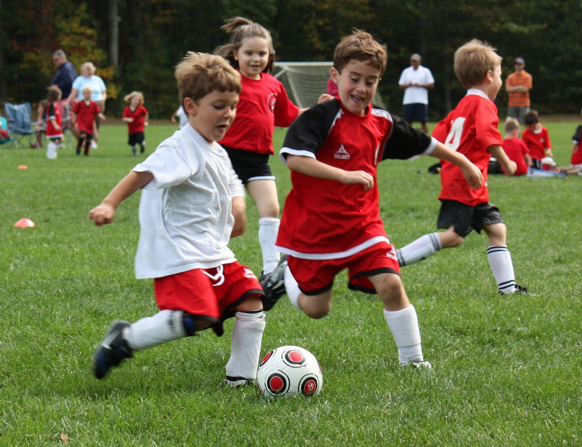
Use Case
Notes:
John’s kids play soccer.

Slide 7
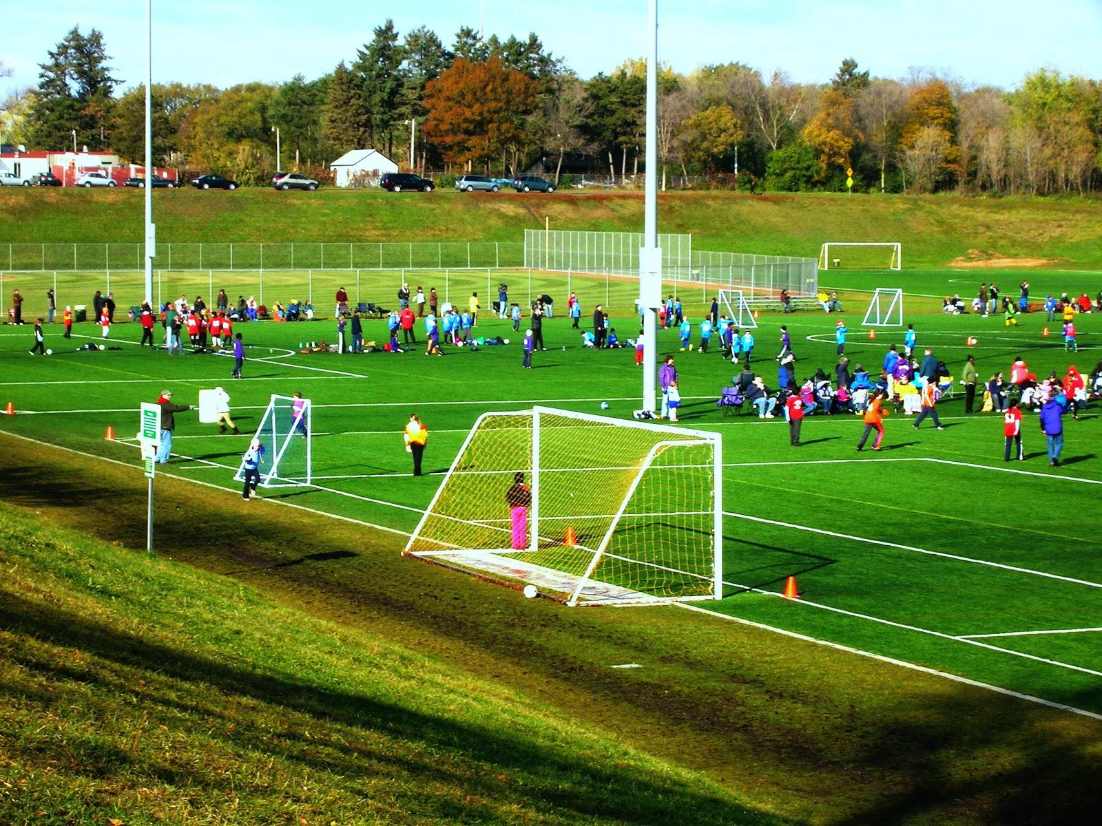
Use Case
Notes:
And every weekend they go down to the local youth league for their next big game.

Slide 8
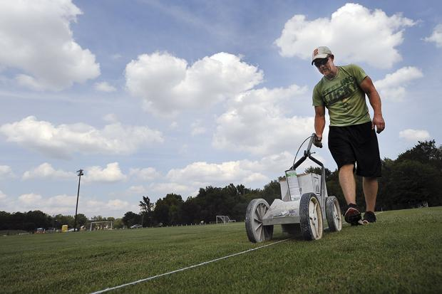
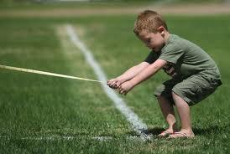
Use Case
Notes:
John sometimes helps the league paint their lines. He even gets the kids to help

Slide 9
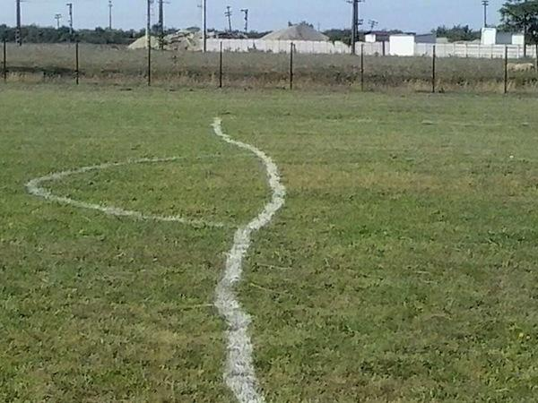
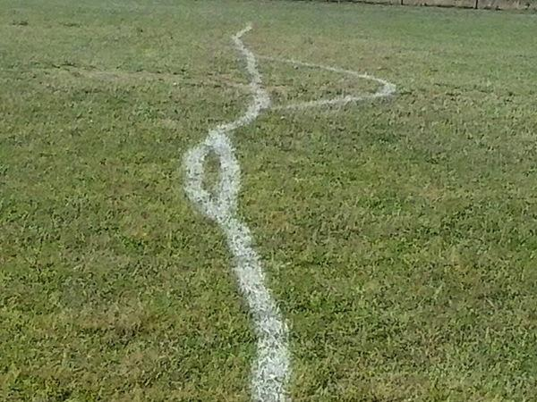
Use Case
Notes:
But since the league uses a combination of volunteers and employees, the standards for the lines are a little bit off.

Slide 10
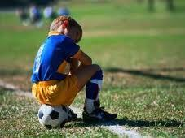
Use Case
Notes:
This sometimes makes it hard for the kids to have fun.

Slide 11

Use Case
Notes:
And the management team for the parks wants to help.

Slide 12
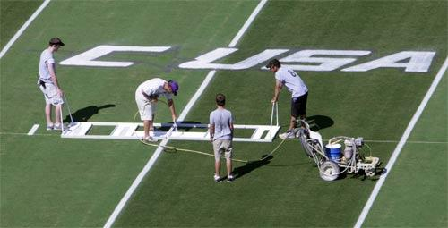
Use Case
Notes:
But they can’t afford the professional painting teams or even a full time staff member to maintain the field.

Slide 13
Use Case
Notes:
So they decide to buy fieldroid

Slide 14
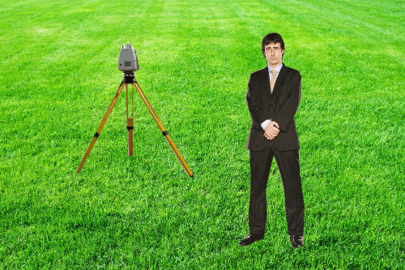
Use Case
Unfold legs of tracking station
Place station away from location of lines
Wait for station to calibrate
Station will begin tracking the robot
Notes:
Using the robot is much easier than before. John volunteers to run the robot this week, which is easy enough for a volunteer
-First He sets up the tracking station by unfolding the legs
-He places it on the field far away from where the lines will be
-He turns on the station and waits for the lights to turn green
-The tracking station gets its GPS location
-And the station begins scanning for the robot

Slide 15
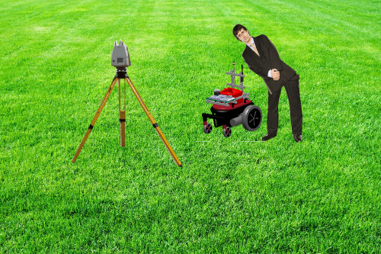
Use Case
Fill the robot with paint
Put the robot at a corner
Open the user interface
Notes:
John fills up the robot with paint
He then turns on the robot and places it at the corner of the field

Slide 16
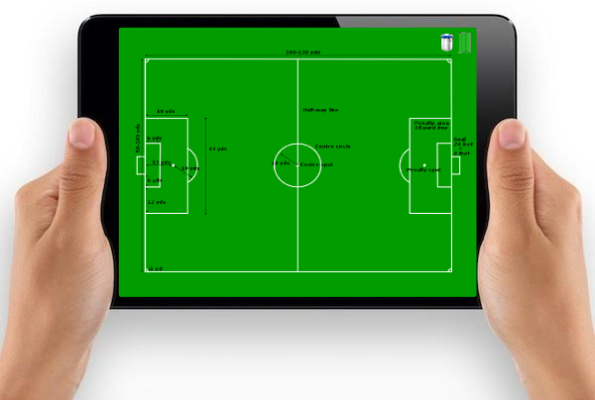
Use Case
Select the field type and size
Check the battery and paint readings on the robot
Click the “Go” button to start the painting process
Notes:
John then selects his field and dimensions from the system interface
He can see the battery level and the amount of paint in the system
Once all the settings seem good, he clicks the go button and lets the robot paint the field

Slide 17
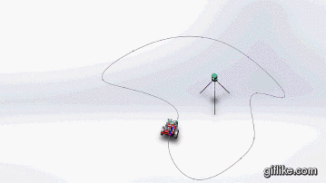
Use Case
Notes:
It takes about 2 hours to paint a full soccer field without the need for stopping to refuel.
Notice that no one needs to be present to make sure the robot completes its job as it will notify the user of the status along the way.
So now Ander’s going to talk about our systems engineering on this project.
http://i.giflike.com/0S1PBzp.gif

Slide 18
Mandatory Functional Requirements (MFR)
MFR1 | Perform 100% of autonomous tasks without requiring constant user supervision
MFR2 | Paint 100% of the line markings according to league standard regulations
MFR3 | Plan a path within 1 minute given user inputs
MFR4 | Report robot’s position to user interface once every 4 seconds
MFR5 | Stop if an obstacle is detected within 1 meter
MFR6 | Stop within 2 seconds of receiving an emergency stop command
MFR7 | Stop if communication with command station times out for 10 seconds
Notes:
After analyzing our needs and problem description, we have defined a set of requirements for our system and associated a performance metric where applicable. These performance metrics will be validated in our Fall and Spring validation experiments.
In general, our requirements call for a system capable of accurately painting a field with minimum supervision. These align with the “Set and Leave it Alone” operation for our system.

Slide 19
Mandatory Non-Functional Requirements (MNFR)
MNFR1 | Paint over the same path with 10cm of error deviation
MNFR2 | Paint within 5cm of its desired path
MNFR3 | Be operable by personnel of minimum work age in the US
MNFR4 | Have a set-up time of 5 minutes
MNFR5 | Spend 2 hours to paint a field
MNFR6 | Be capable of operating for 3 hours without replenishing resources
MNFR7 | Paint without physically damaging the field
Notes:
Some of our MNFR call for a system capable of repeating a paint task with high accuracy and precision. We also have to provide a solution that is fast, safe, and easy to use.
Finally, we have to provide a solution that does not damage the field it paints.

Slide 20
Desirable Functional Requirements (DFR)
DFR1 | Monitor consumption of resources
DFR2 | Plan the most time-efficient path within 2 minutes
DFR3 | Report the robot’s current status once every 5 seconds
DFR4 | Paint complex graphic designs
DFR5 | Paint in multiple colors
DFR6 | Move around obstacles detected along its path
DFR7 | Relocalize itself if it gets lost while performing an autonomous task
Notes:
We have also identified a set of desirable requirements. These requirements add capabilities and features to our system which will allow it to complete a wider set of tasks.
We would like to have a system that can paint complex designs like sponsor logos and team emblems. We would also like to have a system that navigates around obstacles rather than stopping completely and requiring user intervention.

Slide 21
Desirable Non-Functional Requirements (DNFR)
DNFR1 | Provide an affordable field-painting solution of $4,000
DNFR2 | Be operable using a mobile device application
DNFR3 | Report battery life, paint consumption, percentage of task completion, and current state to mobile device application
DNFR4 | Be adaptable to other sport field types and terrain
DNFR5 | Require only 1 person to handle and deploy the system
Notes:
We would also like to provide a solution that is within $4,000. Currently this is no possible with the use of an expensive localization system.
We would also like to create a downloadable mobile app so that anyone with our platform can easily deploy the robot on any field.

Slide 22
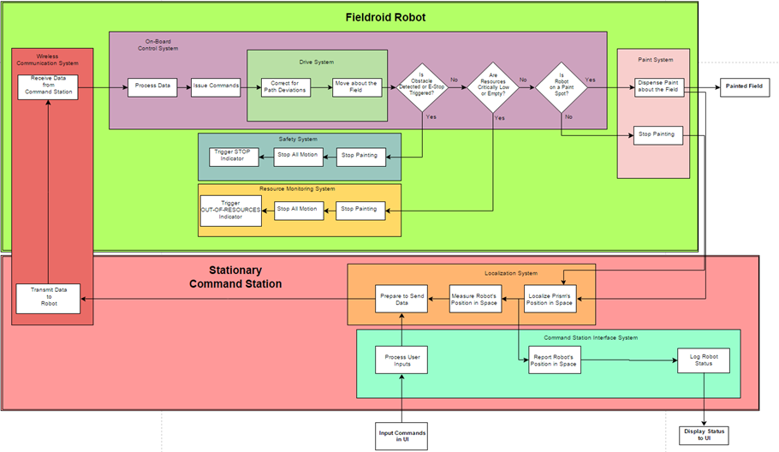
Functional Architecture
Notes:
Based on these set of requirements, we can define a Functional Architecture for our system.

Slide 23
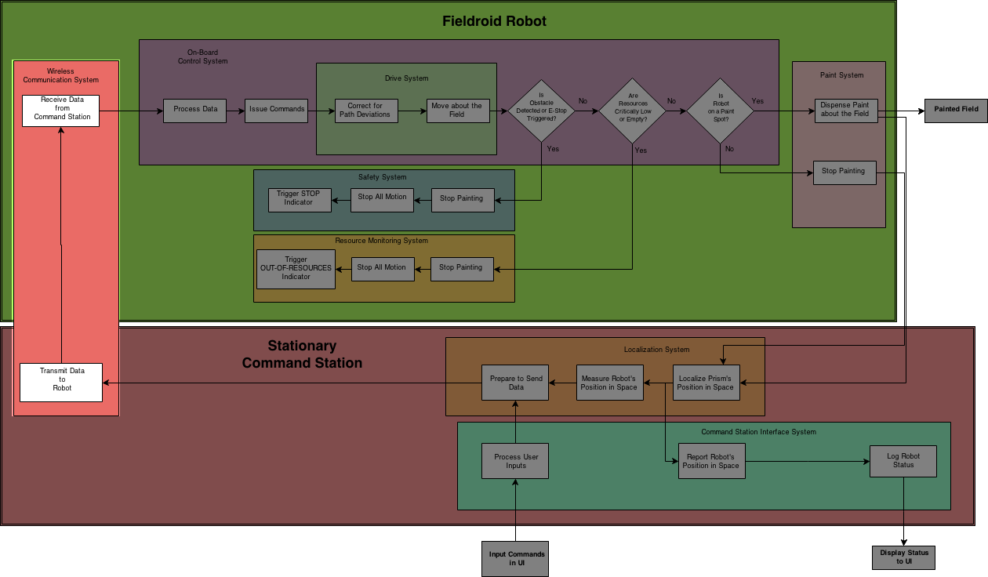
F.A. - Communication Systems
Notes:
Starting with the red vertical box on your left,

Slide 24
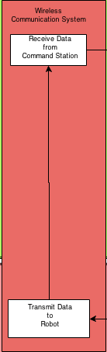
F.A. - Communication Systems
Notes:
We have our one-way communication system between the command station and mobile robot platform.

Slide 25
F.A. - Communication Systems
Notes:
Information from the Command Station, then feeds into the

Slide 26
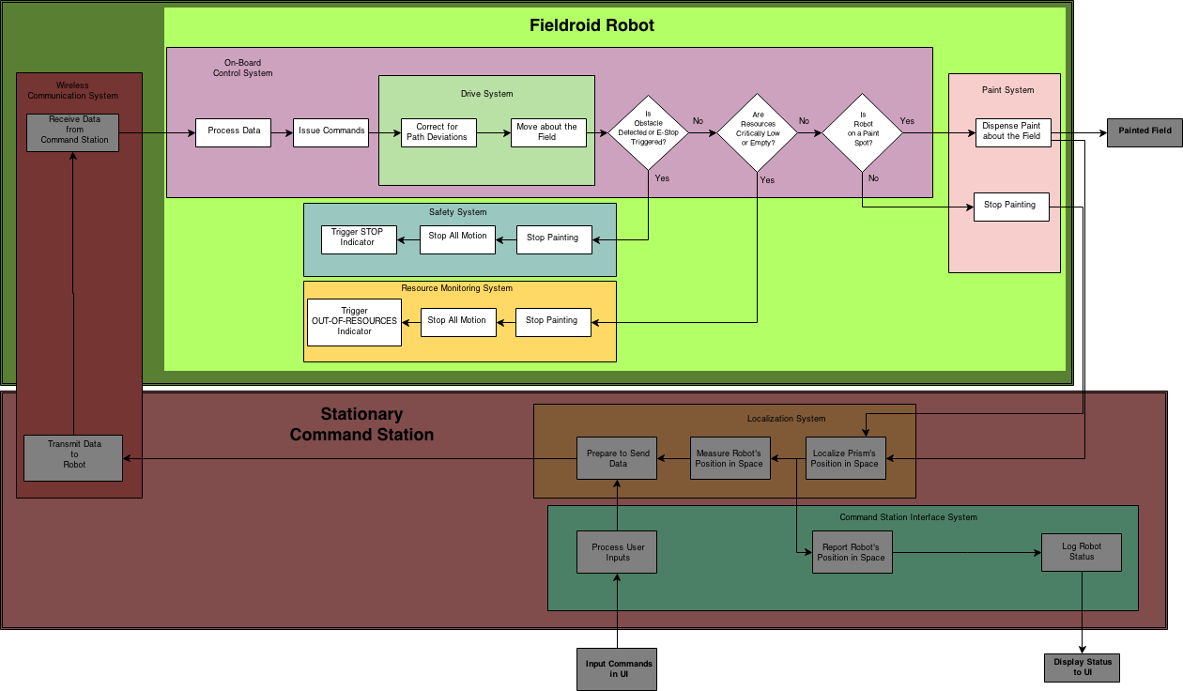
F.A. - Control, Safety, Monitoring, and Paint Systems
Notes:
Control system unit of Fieldroid.

Slide 27
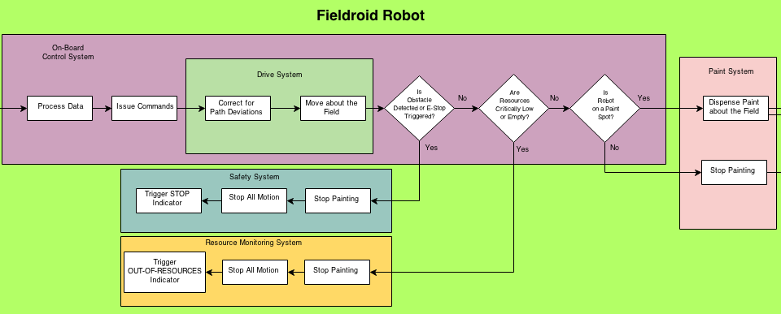
F.A. - Control, Safety, Monitoring, and Paint Systems
Notes:
Here it process the data and issues the necessary commands to the Drive System.
It is critical to check if an obstacle has been detected or E=stop command has been received. The robot then checks to see if it has enough resources to complete its task.
Finally the robot checks to see if it is on a paint spot or not before dispensing paint on the field.

Slide 28
F.A. - Control, Safety, Monitoring, and Paint Systems
Notes:
Next, a laser ranger finder in the command station,

Slide 29
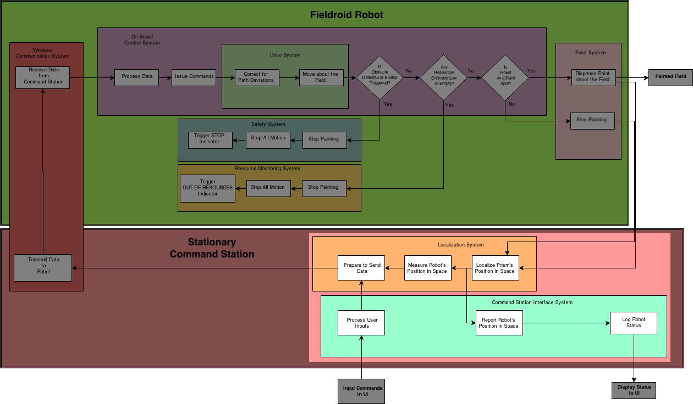
F.A. - Localization and UI Systems

Slide 30
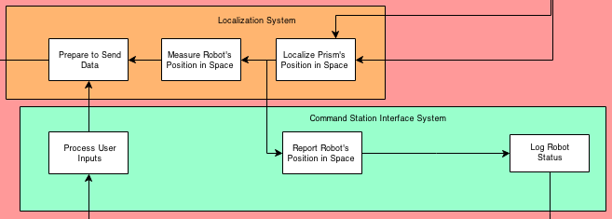
F.A. - Localization and UI Systems
Notes:
Reads the the position of the robot in space and reports its position to the user interface.
Positioning data and user commands are bundled up before being transmitted back to the mobile platform.

Slide 31
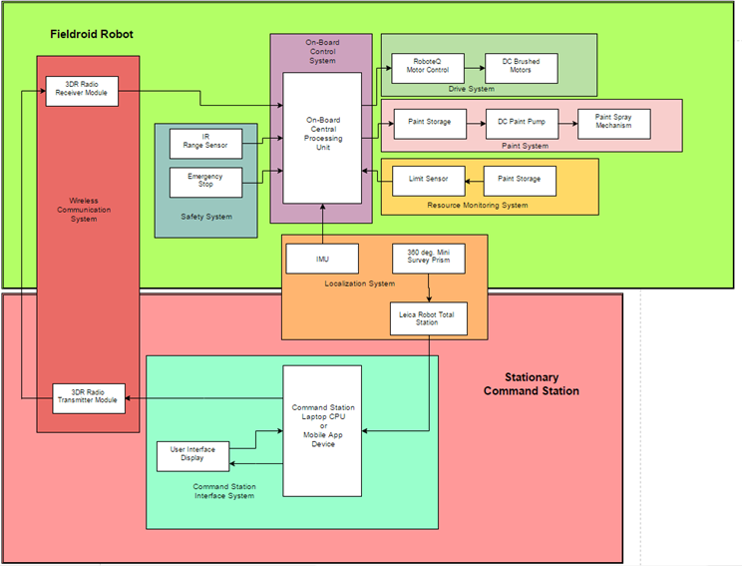
Physical Architecture
Notes:
Our PA reflects physical subsystems that accomplishes the tasks highlighted in our FA.

Slide 32
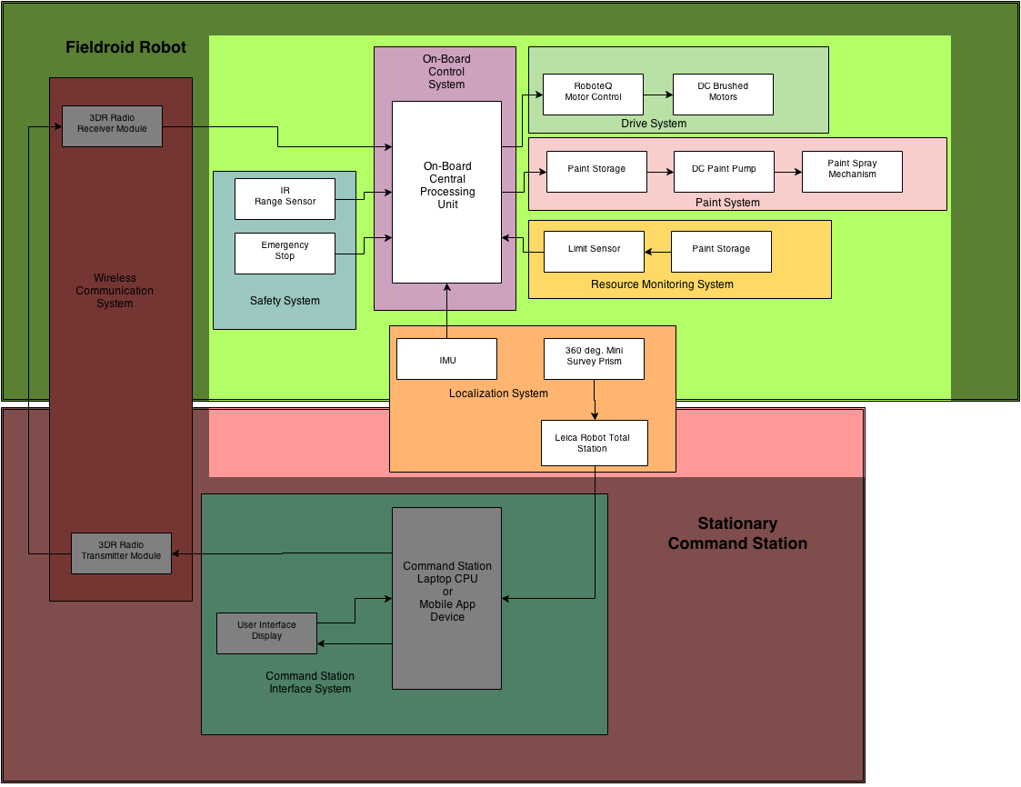
P.A. - Fieldroid Subsystems
Notes:
Starting with the mobile robot,

Slide 33
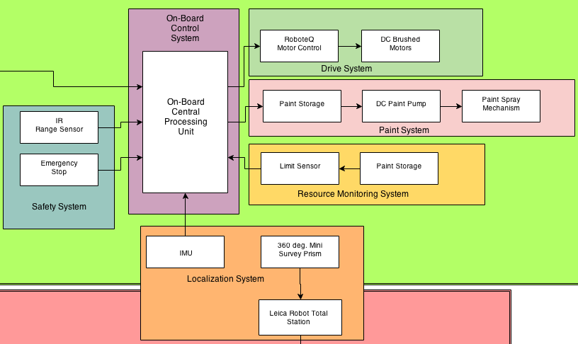
P.A. - Fieldroid Subsystems
Notes:
The on-board CPU receives localization feedback and issues commands to the drive system and paint system. The CPU also gathers information from the safety system and
resource monitoring systems and responds to them accordingly.

Slide 34
P.A. - Fieldroid Subsystems

Slide 35
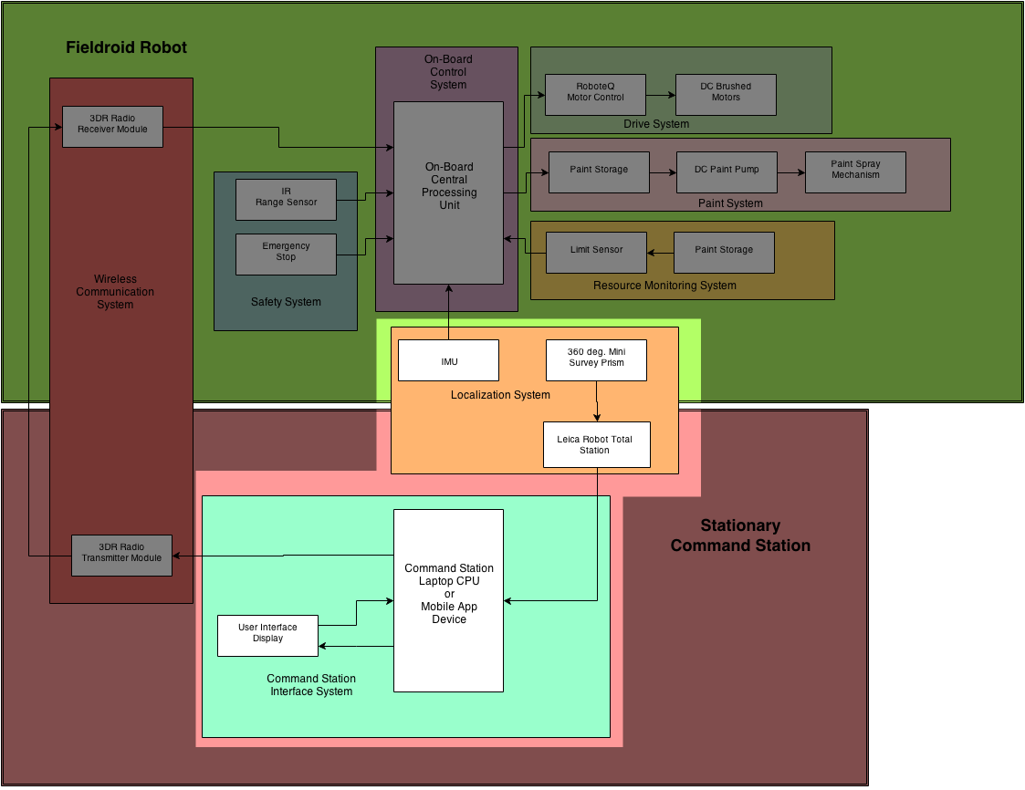
P.A. - Command Station Subsystems
Notes:
For our main localization system present in the command station,

Slide 36
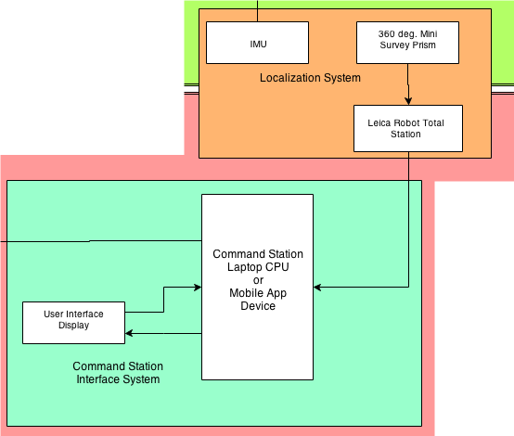
P.A. - Command Station Subsystems
Notes:
A Leica Robot Total station tracks the position of a 360deg reflective prism mounted on the robot.
A laptop on the command station receives the localization measurements and interacts with the user interface. The laptop also sends the data back to the mobile device via radio communication.
And now I’ll let Jaghvi explain the subsytems.

Slide 37
Subsystem Descriptions
Major Subsystems:
Localization
Drive
Paint
Power
User Interface
Notes:
Concisely describe and, if appropriate, depict each major subsystem.
I am going to address all the subsytem descriptions

Slide 38
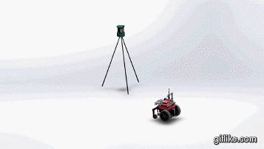
Localization Subsystem
Leica Total Robotics Station
360 Degree Prism
IMU
Motor Encoders
Notes:
http://i.giflike.com/t2KMtxZ.gif
Leica shoots a lazer at the tracking prism
we are able to obtain precise position of our robot n environment and IMU and encoder will help us obtain more precise and accurate data

Slide 39
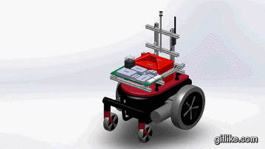
Drive Subsystem
Chassis
Motors
Drive Wheels
Caster Wheels
Roboteq Motor Controller
External Framing
Notes:
http://i.giflike.com/ZgblHlN.gif
http://i.giflike.com/qyWlwxL.gif
sensible machines gave us this electrical wheel chair base and this has solved our drive system problem
external framing to mount more

Slide 40
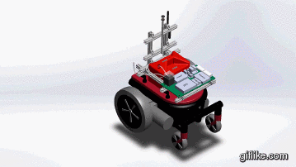
Paint Subsystem
Paint Container
Paint
Pump
Tubing
Nozzle
Notes:
http://i.giflike.com/Mown1Ll.gif
gas can , controlling pump thru relay connected to cpu, using waste wateer pump

Slide 41
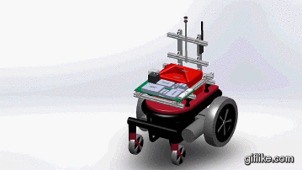
Power Subsystem
Drive System Batteries
Non-Drive System Batteries
Breaker
Power Board
5V Relay
12V Relay
I/O Board
CPU
Notes:
http://i.giflike.com/Q2MflUA.gif
separate Drive power system is different from power system
one to power drive and other to power other systems
and

Slide 42

User Interface
The Fieldroid App
Notes:
second sem goals , non functional requirement to be operable using a mobile application
what reequirement

Slide 43
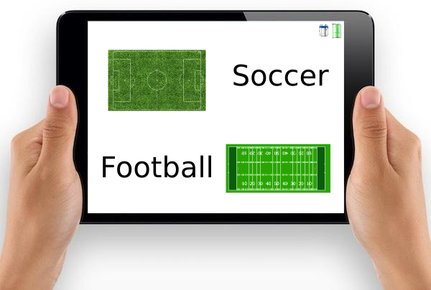
User Interface
Select the field type

Slide 44
User Interface
Select the Dimensions

Slide 45

User Interface
Start painting!

Slide 46
Current System Status
Control Processing Unit
Localization System
Drive System
Paint System
Mechanical Design
Communication System
Power System

Slide 47
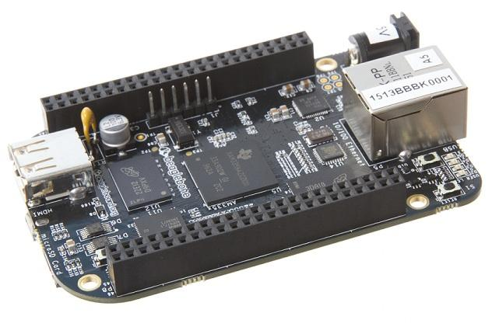
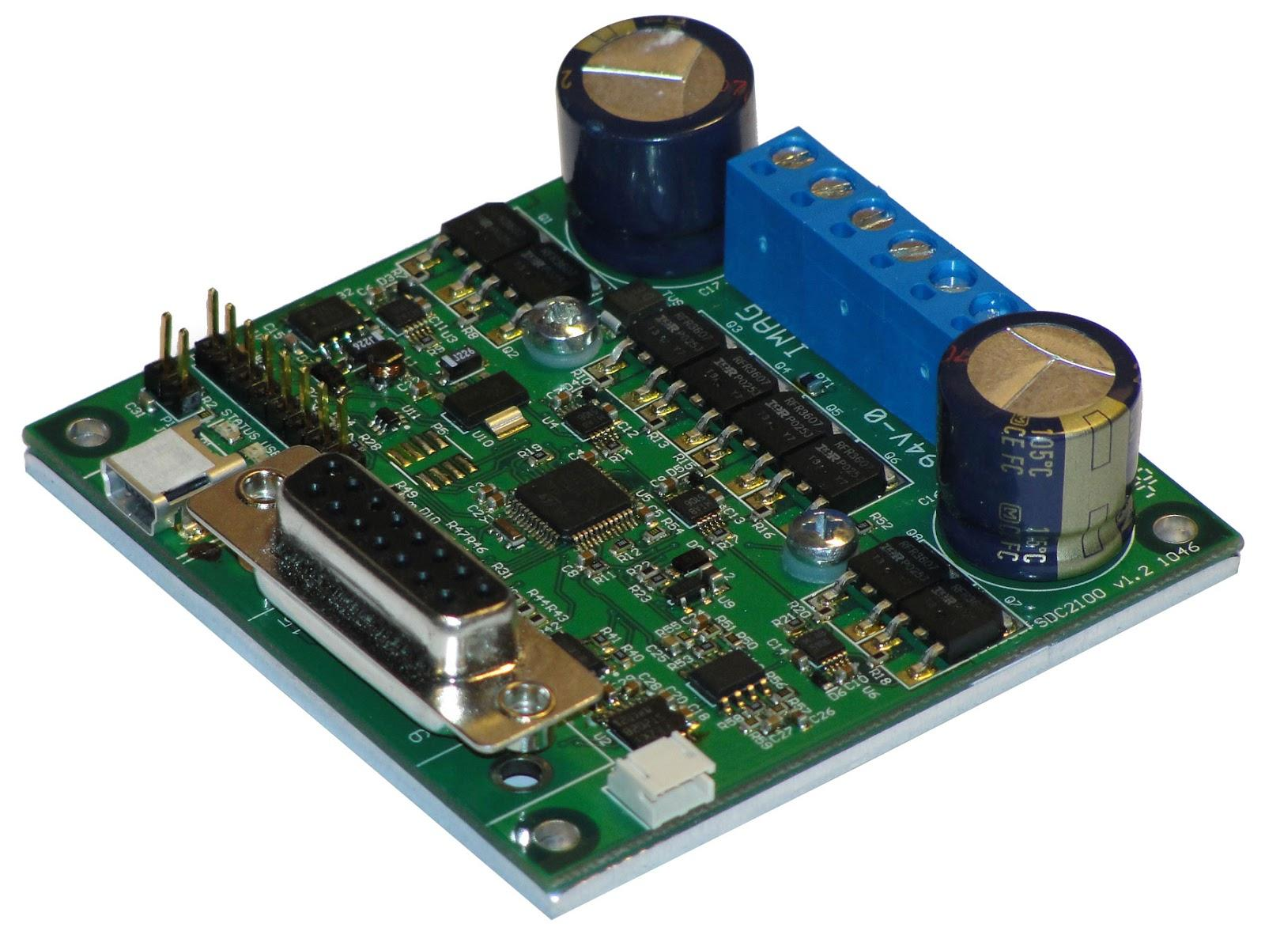
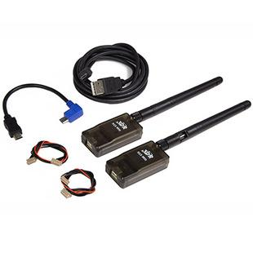
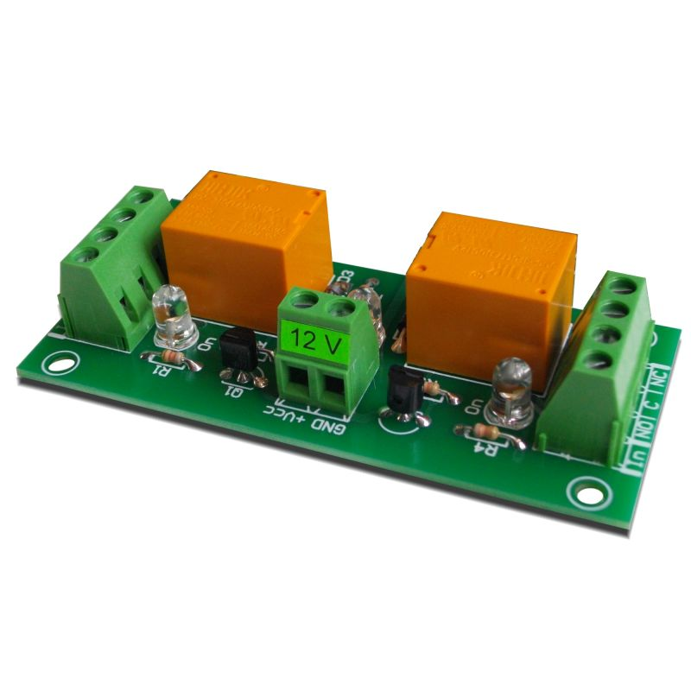
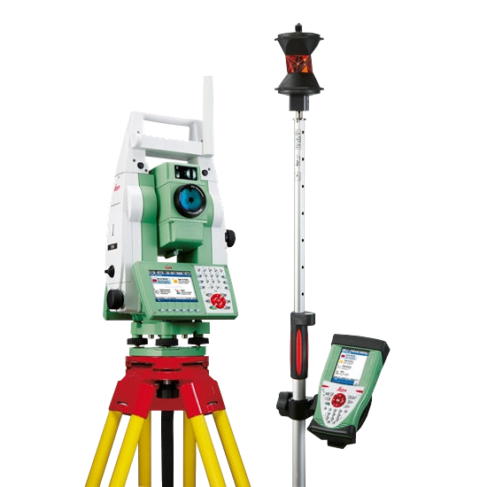
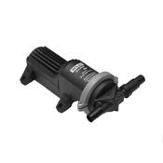
On-Board CPU
Beaglebone Black
Drive Subsystem
Communication Subsystem
Radios
RoboteQ motor-controller
Stationary
Command
Station
Relays
DC Pump
Paint Subsystem

Slide 48
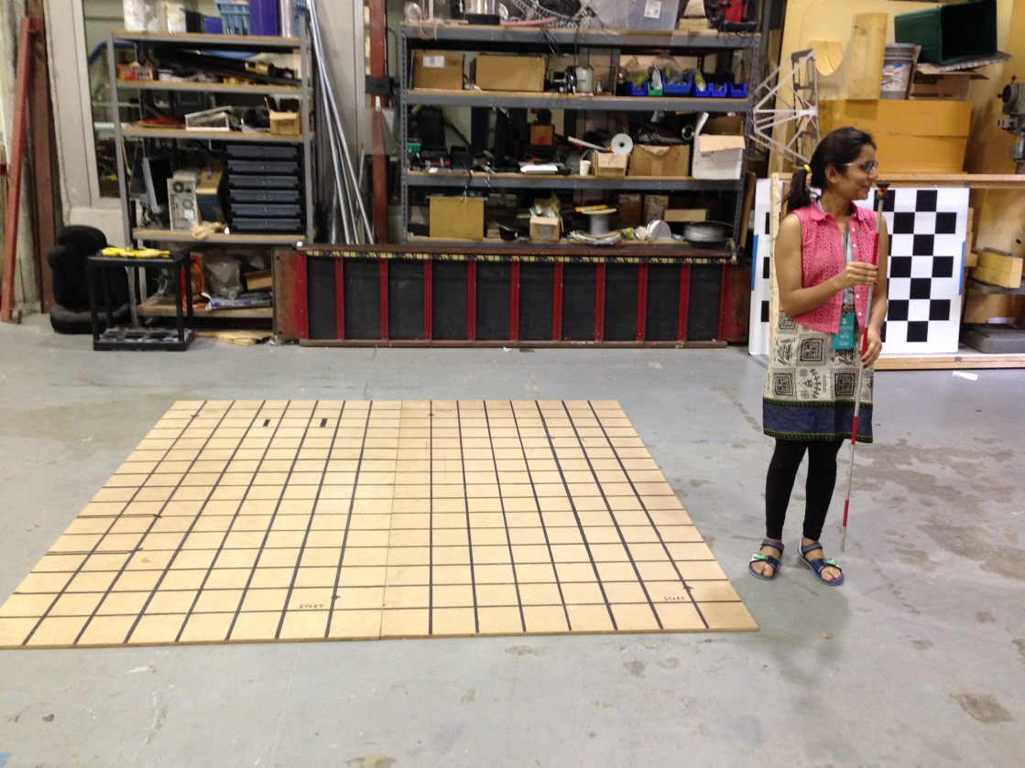
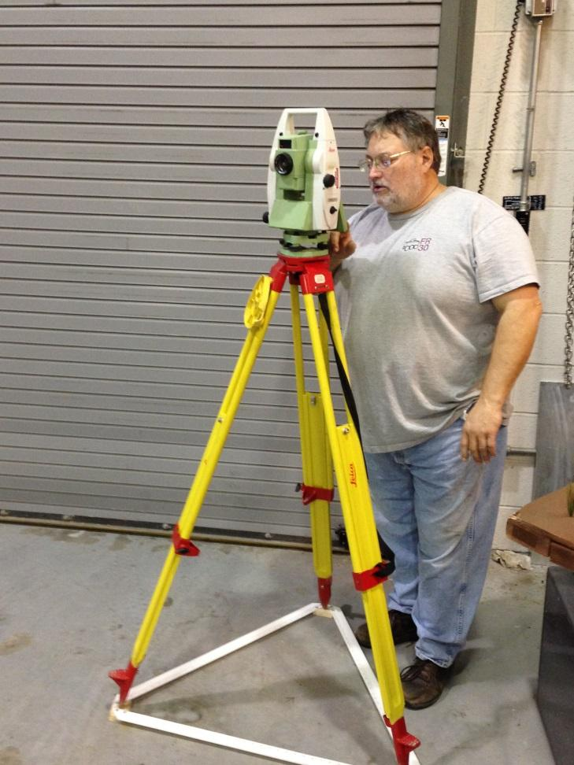
Localization System
Performed tests with Chuck Whittaker at the FRC
Tested for the reliability and feasibility indoors
Tested system error
Simulated a robot’s trajectory around a square
Tracking Prism
Leica Station
Notes:
performed testes ...to validate localzation
acquire reliable sensor data
we moved around a sqaure

Slide 49
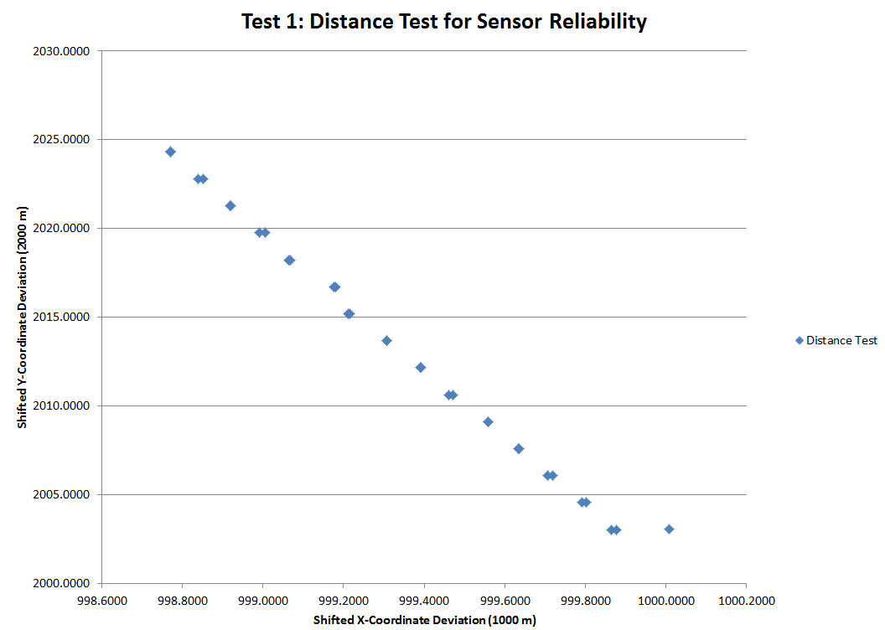
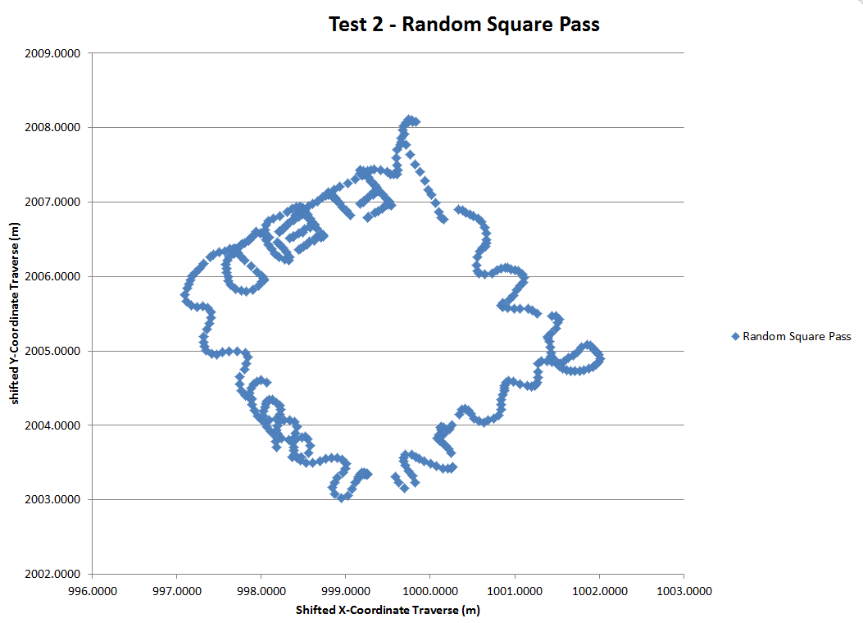
Localization System
Test 1- Distance Test Test 2- Performance Pass
Notes:
Test1:Tiny error deviations (in mm) due to user error
Test4:Goal was to test the Leica’s tracking abilities by suddenly varying speeds, travel direction, and overlay in an indoor environment
80ft line to see how much data deviated from each other

Slide 50
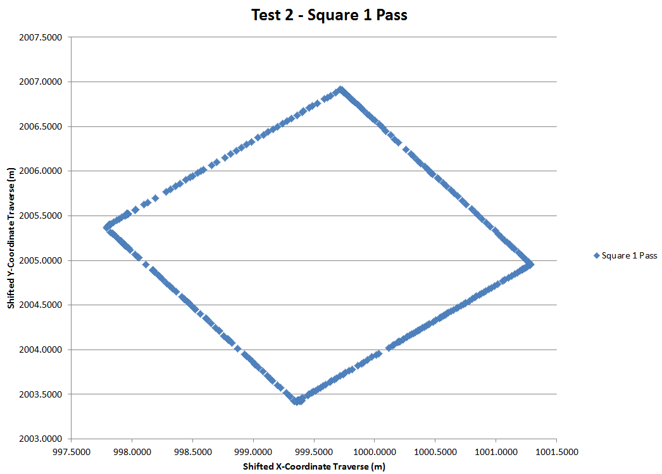
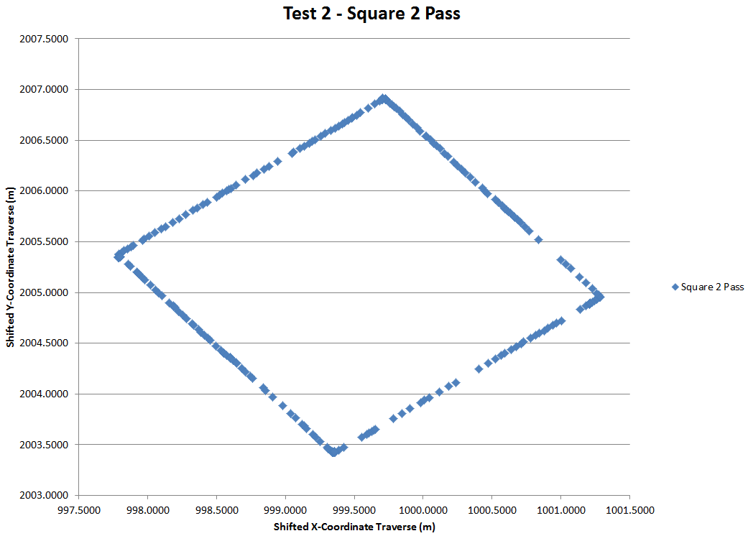
Localization System
Test 2- Square Pass1 Test 2- Square Pass2
Notes:
we took two different set of measurements, first one as you can see is more continous for tracking prism was moved along the square at a slower pace and second one we moved the tp at faster pace but we were still able to retain the shape. Te results of this experiments are quite precise and are in 4mm o

Slide 51
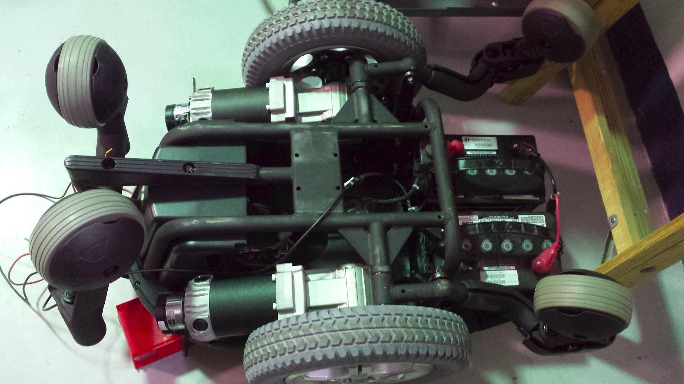
Drive System
Can communicate with the RoboteQ motor-controller to drive our base using C++
Can tele-operate it using keyboard keys
RoboteQ Motor-controller
Robot Base

Slide 52
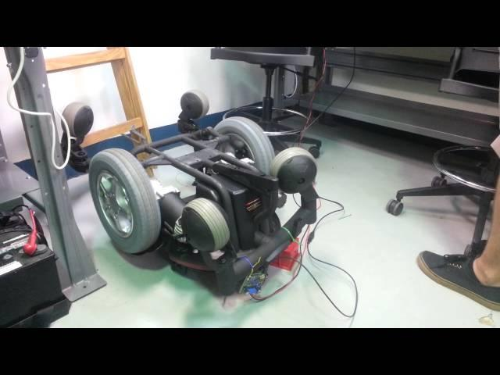
Drive System

Slide 53
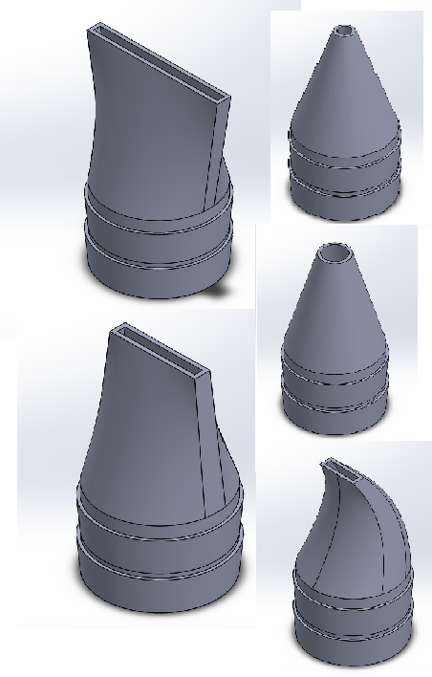
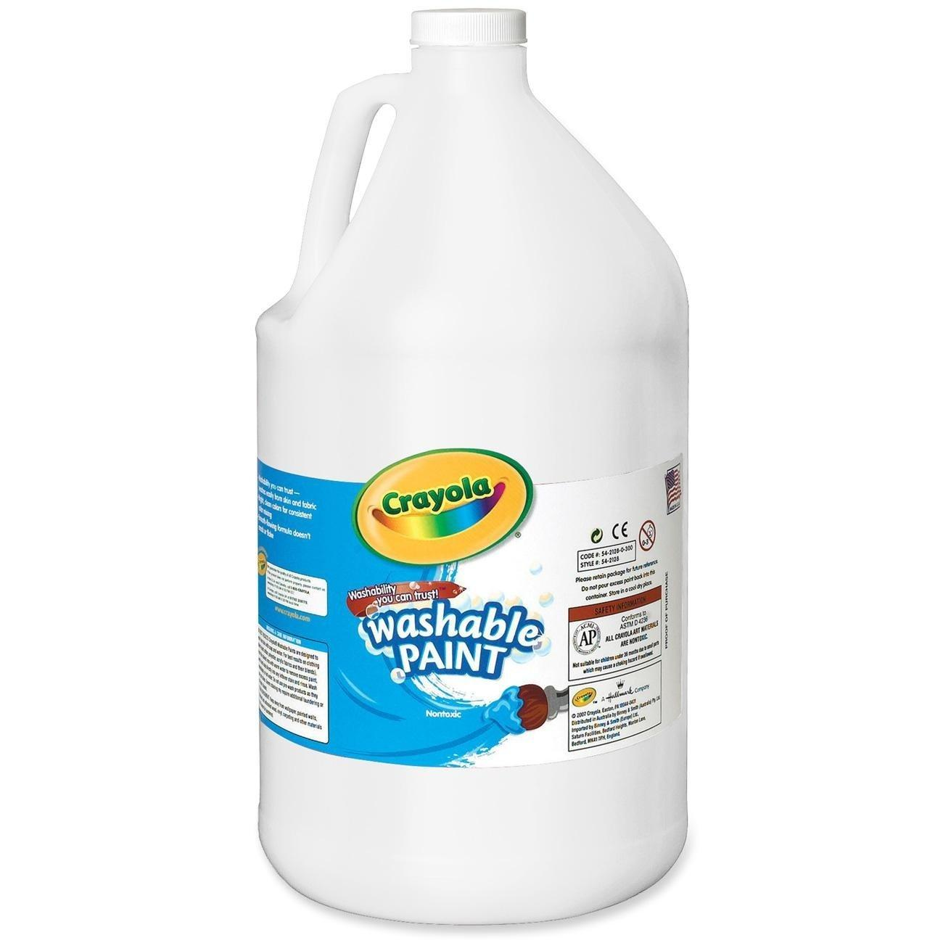

Paint System
Selected major paint system components
Designed different nozzle in CAD
Using a waste water pump
Using washable paint for initial prototype
DC Paint Pump
Nozzle Designs
Washable Paint
Paint Can

Slide 54



Mechanical Design
Designed a CAD model
Built the chassis needed to mount electronics
CAD design of FielDroid
Chassis
Notes:
we started by designing the cad model for entire system and on the basis of that constructed our chasis to mount electronics

Slide 55


Communication System
Using 3DR radios to establish communication between the survey gun station and robot
Can configure the firmware of the radios to set BPS, Net ID, Frequency Range, Transmission Power, etc
Two-way communication is complex with 3DR radios
Trying to establish one-way communication
915MHz 3DR radios
Transmitter radio Receiver radio

Slide 56





Power System
Developed the schematic
Chose components
Currently working on the layout
5V relay
7.4V,6.6A Li-ion Batteries
Voltage regulators
12V relay
2-Pin molex connectors

Slide 57

Power Board Schematic

Slide 58

Work Breakdown Structure
Notes:
Work Breakdown structure
-Split up the work by subsystem, with two pseudo subsystems
-Things like localization, paint and power
-We integrate these subsystems through the integration pseudo subsystem
-We manage it with project management
We then break each sub or sudo subsystem down by expertise, mech, ee, cs
We want to make sure each task, no matter who it is given to, has an ‘expert’ they can go to to get help

Slide 59

Work Breakdown Structure
Notes:
So here is our entire work breakdown structure. It is a little cumbersome, but I think our schedule better depicts the important tasks here.

Slide 60

Schedule
Notes:
We keep our schedule in Gannt chart form.
Green is obviously good and marks completion of tasks
Red is bad and marks tasks that have gone over the deadline and still not complete.
Blue is completed tasks beyound deadlines
Yellow is yet to be completed
Gray is when we planned to start
Our schedule is broken down daily and extends through december
For our next Project Review in purple, we plan to do a bunch of small tasks like demonstrate radio communication, show live data from the tracking station and drive our robot base

Slide 61

Schedule
Notes:
The following review will have items like proper data transfer from the tracking station to the CPU and some motion planning in the form of a rectangle.
Project Review 5 will demonstrate our full painting system.

Slide 62

Schedule
Notes:
Finally, here are our 2nd semester goals running into our spring validation experiment which includes …

Slide 63
Fall Validation Experiment
Paint a Rectangle
Where: Inside the FRC
When: November 24th
What will this show?
Demonstrate a rectangle being painted to prove our method
Localization data will gauge system quality (Speed, Accuracy, Efficiency, etc.)
Paint system validation
18’
12’
10’
24’
16’
Notes:
Leica station:
1.securely mount the tracking station
2.give it an initial position
3.initialize a connection to receive position data and send it to the base
4.paint a Rectangle
Script:
Our Fall Validation Experiment will test our ability to draw a 12’ x 16’ rectangle with a center-line. We consider the center and borderline to be the most important features of a soccer field. This is going to take place on a 24’x18’ canvas that we will tape to the ground.
At the beginning of this test, we will first go through the procedure required to set up the tracking station and our mobile robot This involves:
First, firmly mounting the tracking station 10 ft away from the rectangle
Next, the user has to manually aim the tracking laser at the 360 degree prism to acquire an initial position
Next, we will acquire a connection to the tracking station with a pc and begin transmitting data to the fieldDroid
At this point, we can sit back and watch the bot paint our design.
So why this test?
First, this will be a proof of concept demonstrating our method of localization and navigation
Second, we will gain valuable localization data which we can use to gauge system features such as speed, accuracy and effiiency. This will tell us what we need to refing during the 2nd semester
Finally, we haven’t built a paint system before and this will test whether our current method of painting is reliable or not

Slide 64

Spring Validation Experiment
Paint a soccer field
Where: TBD (Hagen’s Back Yard)
When: TBD (May 2014)
What will this show?
Time lapsed video demonstrating ability to paint regulation fields
Localization data and resource monitoring will verify speed, accuracy, and efficiency
Validate our systems effectiveness in it’s intended environment
Notes:
Procedure:
The procedure to test this system will be much easier as we have added user interface abilities and usability features
Differences: more complex patterns including text, we will be painting on grass in the exact environment our bot is intended for.
Script:
Our spring validation experiment will be a more complex version of the previous experiment where we paint a complete soccer field.
This includes field markings and team names on the side of each field
We will do this outside on a yet to be determined flat plot of grass
The set-up procedure for this test will be much simpler.
Initially, we still need to mount and manually aim the tracking station but
We plan to have a mobile user interface to establish a connection between the tracking station and the FielDroid.
Then all that the user needs to do is select a standard soccer field option and press GO!
We hope to get a time lapsed video of this test to demonstrate our ability to paint the entire field.
We can prove that our system works in it’s intended environment, which is a field grass
We can also use the localization data we recieve from this to verify that we are fulfilling our acuracy, speed, and efficicency requirements

Slide 65
Budget
Purchased
Not Yet Purchased
Received
 | Item | Description | Quantity | Predicted Cost | Actual Cost | Notes
1 | Robot Total Station | Primary localization system | 1 | $2,000.00 | Borrowing
2 | IMU | On board sensor | 1 | $200.00
3 | CPU | Main thinking portion | 1 | $100.00 | $76.93
4 | Wheels | High fidelity needed | 2 + caster | $100.00 | Borrowing
5 | Motors | Precision control is important | 2 | $200.00 | Borrowing
6 | Chassis Parts | Materials for constructing chassis | misc | $100.00 | Borrowing
7 | Paint Pump | Device that pumps paint | 1 | $100.00 | $157.23 | Big Ticket Item
8 | Paint Tubing | Tubes that carry paint between parts | 10ft | $30.00 | $58.59
9 | Paint Nozzle | Controllable actuation | 1 | $30.00 | 3D Print
10 | Paint Container | Container that holds paint on board | 1 | $20.00 | $19.98
11 | Paint | White water-based | 1 gal | $50.00 | $24.49
12 | Radios | Communication between systems | 2 | $150.00 | $107.15
Notes:
a. Budget. Answer these key questions:
i. What is your total budget? ~$1,000
ii. What are the big-ticket items that comprise the majority of your budget? External framing and prism
iii. How much/what percentage have you spent to date? 25% we want some room for spending in the 2nd semester. We have borrowed a lot of our high cost components.
We plan on purchasing the items in red
Script:
Here is our budget sheet. The green items have been recieved, the yellow items have been purchased, and the red items are yet to be purchased.
We initially expected our budget to be just under $4000 but we were able to borrow a few of our most important components from the FRC and our sponsor at Sensible Machines

Slide 66
Budget
Purchased
Not Yet Purchased
Received
 | Item | Description | Quantity | Predicted Cost | Actual Cost | Notes
13 | Motor Controllers | Interface from CPU to motors | 1 | $150.00 | Borrowing
14 | External Framing | Fasteners, attachments, etc | misc | $0.00 | $192.45 | Big Ticket Item
15 | Breaker | Fail-safe electronics breaker | 1 | $20.00 | $32.48
16 | Battery | For power | 1 | $100.00
17 | Ultrasonic Sensor | Close range sensing | 4 | $80.00
18 | Prism | Reflects light from tracking laser | 1 | $300.00 | $194.49 | Big Ticket Item
19 | E-Stop | Button to emergency stop system | 1 | $30.00 | $5.90
20 | 12V Relay | Controllable power to paint pump | 1 | $20.00 | $6.80
21 | 5V Relay | Controllable power to electronics | 1 | $20.00 | $14.90
22 | Canvas | Painting surface for testing | 1 | $50.00 | $17.99
23 | UI Comm | Probably bluetooth for UI | 1 | $60.00
24 | Battery Connectors | Connects batteries to motors | 2 | $0.00 | $18.82
 |  |  | Total | $3,910.00 | $909.38
 |  |  | Percent Spent | 97.75% | 22.73%
Notes:
a. Budget. Answer these key questions:
i. What is your total budget?
ii. What are the big-ticket items that comprise the majority of your budget?
iii. How much/what percentage have you spent to date?
Script:
As a result, we have currently only spent 25% of our $4000 budget.
The most expensive items we bought involved were materials for the frame, a powerful pump for our painting system, and the 360 prism to mount on our bot.

Slide 67

Risk Management
Notes:
Name of risk
Associated requirements
Description of risk
Risk type (cost, schedule, technical, project)
What would cause the risk to be realized and what is the likelihood?
What are the consequences if the risk is realized?
Risk reduction plan
Action planned
Success metrics/expected outcome
Comments
Script:
We created a risk analysis chat to help us predict system issues we may face down the road and we detailed risk reduction plans to mitigate them
We detailed which requirements would be affect by this risk, how they would be affected, why, a likelihood, a severity of consequence and a risk reduction plan.

Slide 68

Risk Management
Notes:
8.2 involves reliable autonomous operation

Slide 69

Risk Management
Major Risks Overview:
8.2 Clock Synchronization
8.3 Localization Feedback Refresh Rate
1.2 Reliable Custom Paint Assembly
1.1 Paint without damaging the field
1.1

Slide 70
QUESTIONS?
Special Thanks to:
Hagen Schempf
John Dolan
Dimi Apostolopolous
Stephan Roth (Mentor, Sensible Machines)
Chuck Whitaker
Luis Navarro
TA’s

Slide 71
Back-Up Slides After This

Slide 72
Rubric
You will also be graded on your delivery (item 9 in the rubric below). Practice as a team ahead of time; include the practice of smooth handoffs from one speaker to another. Adhere to the length limit, speak clearly and without stumbling, face the audience, and be prepared to answer questions crisply and coherently.
Preliminary Design Review Element Weight
1. Project description 0.5 *
2. Use case 1 -
3. System-level requirements 1.5 *
4. Functional architecture 1 *
5. Cyberphysical architecture 1 *
6. Subsystem descriptions 2.5
7. Current system status 2.5 *
8a. Project management: Work Breakdown Structure 1 *
8b. Project management: Schedule 0.8
8c. Project management: High-level test plan 2 -
8d. Project management: Budget 0.7 *
8e. Project management: Risk management 1.5
9a. Length 1
9b. Intelligibility, flow, demeanor, audience connection 2
9c. Handling of Q & A 1
Total: 20

Slide 73
Mandatory Functional (MF) Requirements
The system shall:
Move autonomously about the field
Paint field line markings autonomously on the field
Plan a path given the user inputs
Report robot’s position to a user interface
Detect obstacles on its path
Stop if user issues an emergency stop
Stop if communication with the command station is lost
Notes:
What are the soccer league standard regulations?

Slide 74
MF Performance Requirements
The system will:
Perform 100% of autonomous tasks without requiring supervision
Paint 100% of the line markings according to league standard regulations
Plan a path given the user inputs within 1 minute
Report robot’s position to user interface once every 4 seconds
Stop if an obstacle is detected within 1 meter
Stop within 2 seconds of receiving an emergency stop command
Notes:
What are the soccer league standard regulations?

Slide 75
Mandatory Non-Functional (MNF) Requirements
The system shall:
Contain a reliable localization system
Contain an accurate localization system
Be operable by personnel of minimum work age in the US
Have a relatively quick set-up time
Save time required to paint fields
Hold enough resources to complete a single task
Consist of a small, lightweight platform
Consume less or equal resources than current solution
Notes:
What are the soccer league standard regulations?

Slide 76
MNF Performance Requirements
The system will:
Paint over the same path with 10cm of error deviation
Paint within 5cm of its desired path
Be operable by a 15 year old
Have a set-up time of 5 minutes
Spend 2 hours to paint a field
Be capable of operating for 3 hours without replenishing resources
Capable of being handled by 2 people
Consume 324 oz. of paint per task
Notes:
What are the soccer league standard regulations?

Slide 77
Desirable Functional (DF) Requirements
The system shall:
Monitor the consumption of resources
Plan the most time-efficient path to paint the field
Report the robot’s current status to the user interface
Paint complex graphic designs
Paint graphics using multiple colors
Move around obstacles
Relocalize itself if it gets lost while performing its task
Notes:
What are the soccer league standard regulations?

Slide 78
Desirable Non-Functional (DNF) Requirements
The system shall:
Provide an affordable single solution
Be operable using a mobile device
Report its battery life, paint consumption, and current state to the user interface
Be easily adaptable to other environments or fields
Notes:
What are the soccer league standard regulations?

Slide 79

Stationary Command Station
Notes:
http://i.giflike.com/ixPbTfP.gif

Slide 80

Power Systems Diagram

Slide 81

Signals Systems Diagram

